Slide 1
Execution of a Complete Instruction

Slide 2
Execution of a Complete Instruction
Fetch information from memory to CPU.
Store information to CPU register to memory.
Transfer of data between CPU registers.
Perform arithmetic or logic operation and store the result in CPU registers.

Slide 3
Execution of a Complete Instruction
To execute an instruction, processor has to perform following 3 steps:
1) Fetch contents of memory-location pointed to by PC. Content of this location is an instruction to be executed. The instructions are loaded into IR,
Symbolically, this operation can be written as
IR←[[PC]]

Slide 4
Execution of a Complete Instruction
2) Increment the contents of PC.
PC ←[PC] +4
3) Carry out the actions specified by instruction (in the IR).
• The first 2 steps are referred to as fetch phase; Step 3 is referred to as execution phase.

Slide 5
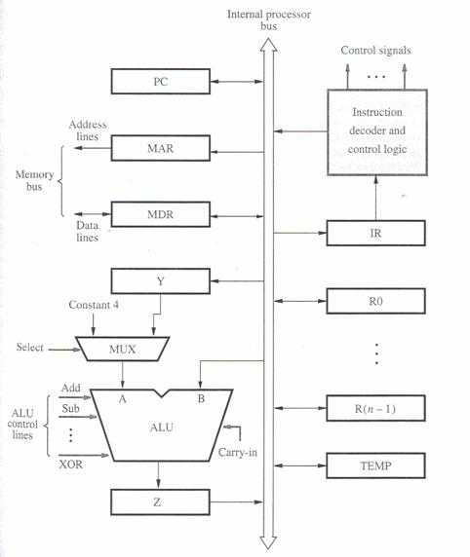

Slide 6
Execution of a Complete Instruction
• The control-sequence is written as follows
1) PCout, MARin, Read, Select4, Add, Zin
2) Zout, PCin, Yin, WMFC
3) MDRout, IRin
4) Rs, MARin, Read
5) MDRinE, WMFC
6) MDRout, Rd, End

Slide 7
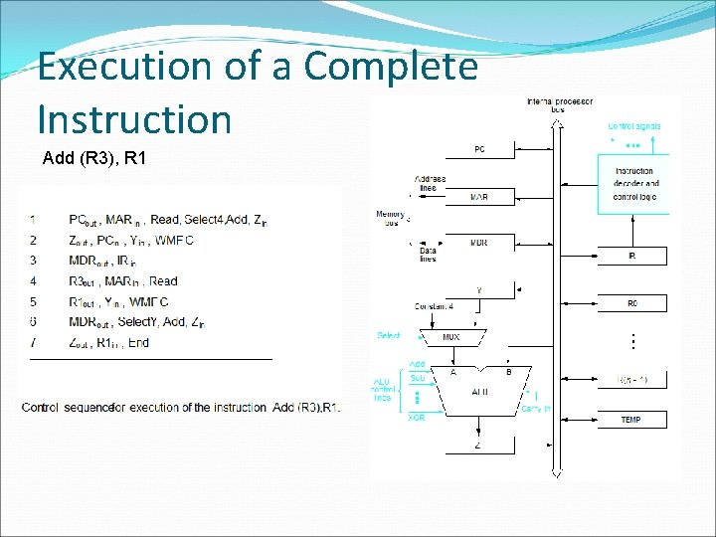

Slide 8
Execution of a Complete Instruction
MDR has 2 inputs and 2 outputs. Data may be loaded
→ into MDR either from memory-bus (external) or
→ from processor-bus (internal).
MAR‟s input is connected to internal-bus, and MAR‟s output is connected to external-bus.

Slide 9
Execution of a Complete Instruction
Instruction-decoder & control-unit is responsible for
→ issuing the signals that control the operation of all the units inside the processor (and for interacting with memory bus).
→ implementing the actions specified by the instruction (loaded in the IR)

Slide 10
Execution of a Complete Instruction
Registers R0 through Rn-1 are provided for general purpose use by programmer.
Three registers Y, Z & TEMP are used by processor for temporary storage during execution of some instructions.
These are transparent to the programmer i.e. programmer need not be concerned with them because they are never referenced explicitly by any instruction

Slide 11
Execution of a Complete Instruction
• MUX(Multiplexer) selects either
→ output of Y or
→ constant-value 4(is used to increment PC content).
This is provided as input A of ALU.

Slide 12
Execution of a Complete Instruction
B input of ALU is obtained directly from processor-bus.
As instruction execution progresses, data are transferred from one register to another, often passing through ALU to perform arithmetic or logic operation

Slide 13
Execution of a Complete Instruction
An instruction can be executed by performing one or more of the following operations:
1) Transfer a word of data from one processor-register to another or to the ALU.
2) Perform arithmetic or a logic operation and store the result in a processor-register.
3) Fetch the contents of a given memory-location and load them into a processor-register.
4) Store a word of data from a processor-register into a given memory-location.

Slide 14
Execution of a Complete Instruction
REGISTER TRANSFERS
• Instruction execution involves a sequence of steps in which data are transferred from one register to another.
• Input & output of register Ri is connected to bus via switches controlled by 2 control-signals:
Riin & Riout.
These are called gating signals.

Slide 15
Execution of a Complete Instruction
When Riin=1, data on bus is loaded into Ri. Similarly, when Riout=1, content of Ri is placed on bus.
When Riout=0, bus can be used for transferring data from other registers.

Slide 16
Execution of a Complete Instruction
PERFORMING AN ARITHMETIC OR LOGIC OPERATION
• The ALU performs arithmetic operations on the 2 operands applied to its A and B inputs.
• One of the operands is output of MUX & the other operand is obtained directly from bus.
• The result (produced by the ALU) is stored temporarily in register Z

Slide 17
Execution of a Complete Instruction
The sequence of operations for [R3]←[R1]+[R2] is as follows
1) R1out, Yin //transfer the contents of R1 to Y register
2) R2out, SelectY, Add, Zin //R2 contents are transferred directly to B input of ALU. // The numbers of added. Sum stored in register Z
3) Zout, R3in //sum is transferred to register R3

Slide 18
Execution of a Complete Instruction
Write the complete control sequence for the instruction : Move (Rs),Rd
• This instruction copies the contents of memory-location pointed to by Rs into Rd. This is a memory read operation. This requires the following actions
→ fetch the instruction
→ fetch the operand (i.e. the contents of the memory-location pointed by Rs).
→ transfer the data to Rd.

Slide 19


